Slide 1
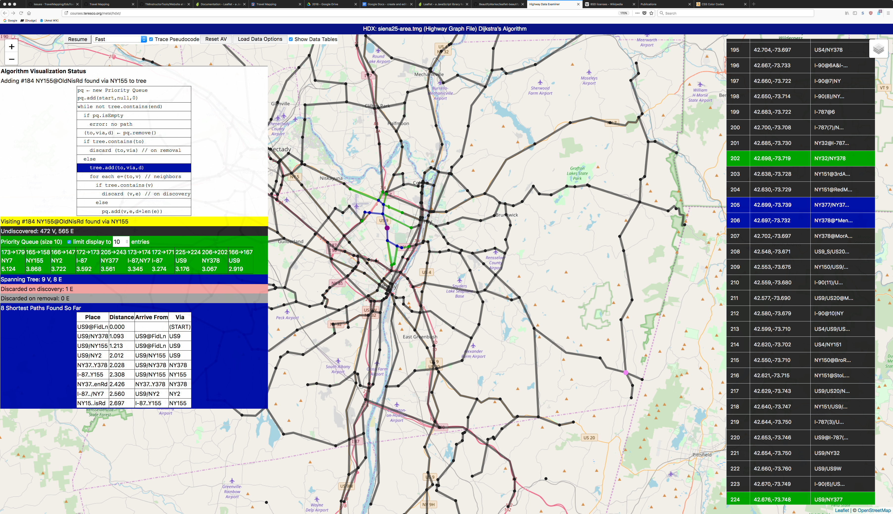
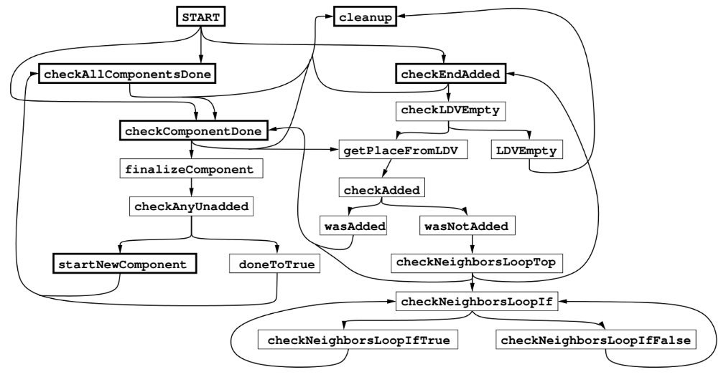
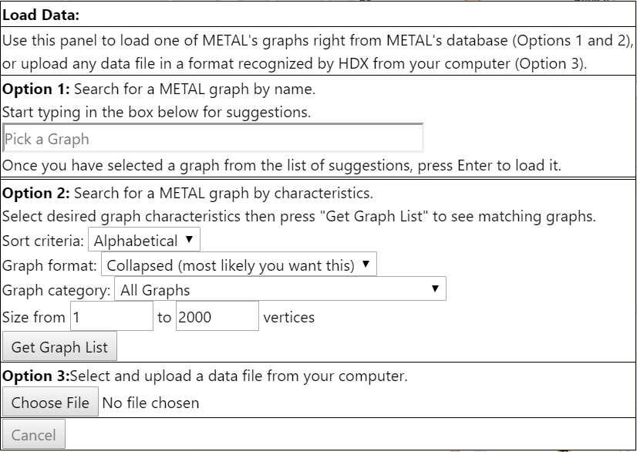
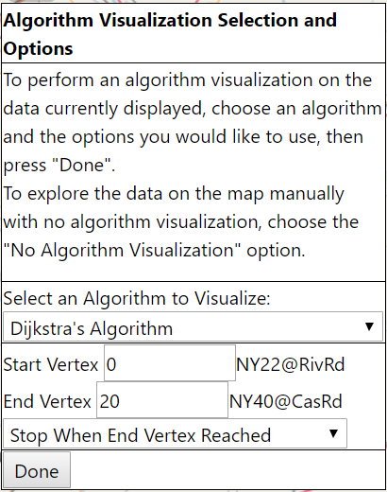
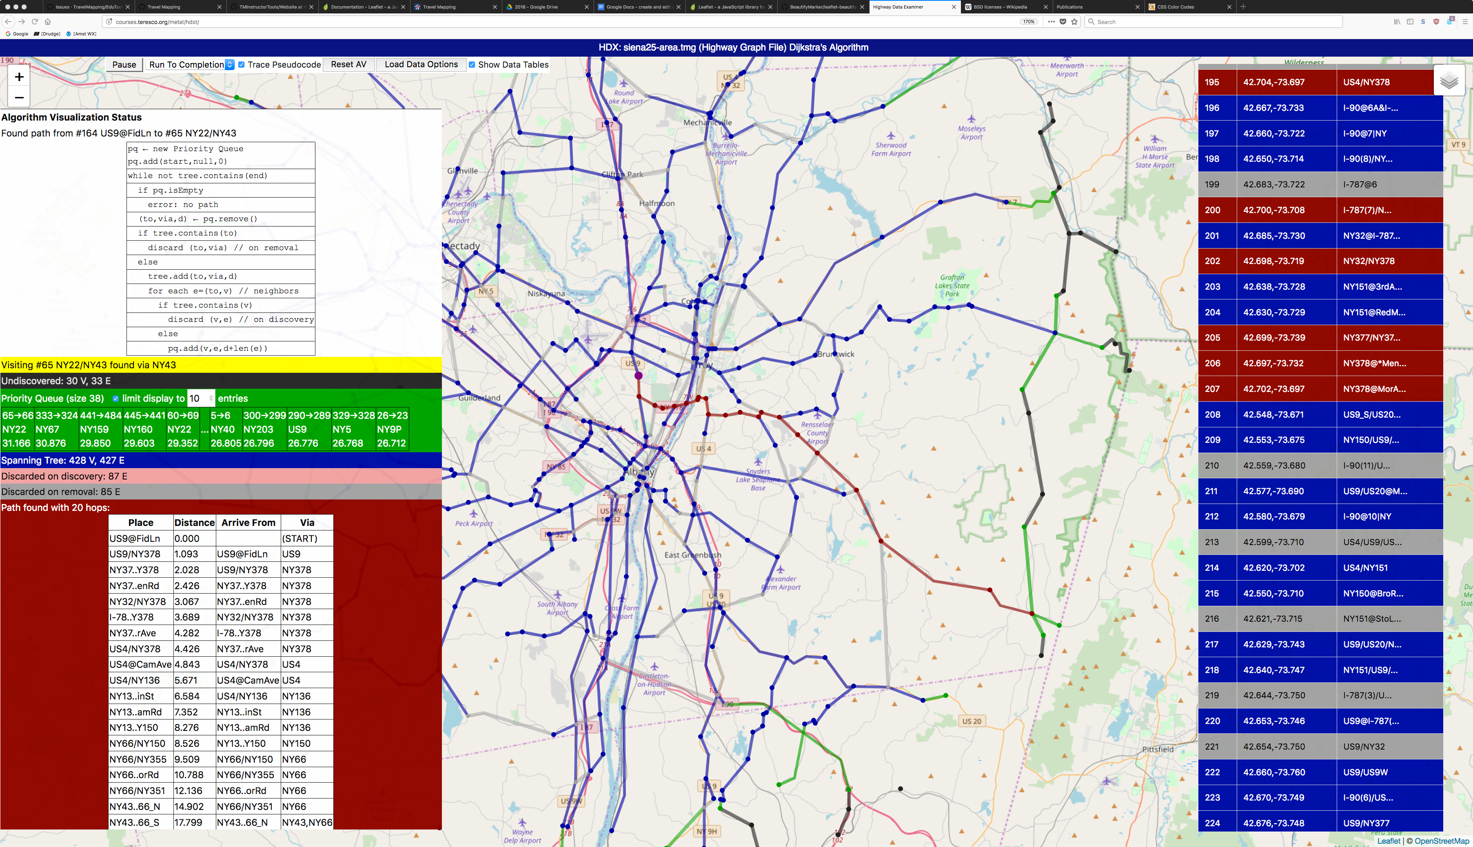

An Improved User Interface and Code-Level Tracing for METAL Algorithm Visualizations
Michael Dagostino, Abdul Samad, Eric Sauer, James D. Teresco (advisor)
Introduction
What is METAL?
Code-Based Algorithm Visualizations
Seeing the effects on algorithm data as lines of code are executed
Action-Based Framework
Map-based Educational Tools for Algorithm Learning (METAL) is an ongoing project that aims to provide data based on real-world highway systems and interactive visualization capabilities to view that data in map and tabular form. METAL's Algorithm visualization (AV) system allows a student to watch one of several algorithms in action on highway data, following changes in key variables and data structures with corresponding color-coded changes to the data on the map. By running on data of various sizes and simulating at various speeds, a student can gain an understanding more quickly and more deeply.
Our redesigned AV engine allows students to watch an AV's progress, with lines of code highlighted as they execute, color coded consistently with variables and data structures, along with consistent color-coded changes on the map.
Our new framework requires that each of our
algorithms be specified as a series of actions. Each action performs a small step toward the solution, and is responsible for updating all parts of the AV as appropriate.
Summer 2018
Improvements to the project
Above, we have the actions that specify METAL's graph traversal, spanning tree, and shortest path AVs. It is important to note that these actions are seen and need to be understood only by METAL developers, not users.
Our Summer 2018 work on METAL focused on enhancing its interactive map-based AV capabilities in three major areas: user interface (UI) improvements, new AVs, and adding code-level AVs.
Dijkstra’s Algorithm soon after it’s started
Future Work
With the action-based framework in place, it is now more straightforward to add new algorithms to METAL, and we intend to add many more. There are many potential directions to pursue. Priorities will continue to be set based on student feedback as METAL is used in more courses.
Acknowledgements
The Summer Scholars 2018
project was funded by the Center
for Undergraduate Research and
Creative Activities (CURCA) at
Siena College. METAL's web site http://courses.teresco.org/metal/ includes highway data and AV capabilities in the Highway Data Examiner. Further details about METAL and its use as a pedagogical tool can be found on the web site and in the publications listed there.
METAL's highway data is derived from the Travel Mapping Project (http://travelmapping.net).
The new Control Panel and User-Interface
User Interface
METAL's UI was redesigned to allow a student to load
data to the system more quickly and easily, and to break
up the UI into a series of controls that are shown only
when relevant. Options were also added to proceed
through an AV one step at a time, or to run it to
completion.
Dijkstra’s Algorithm after finding the solution

